Slide 1


ENHANCING AND OPTIMIZING ASSET AND EQUIPMENT LIFECYCLE MANAGEMENT THROUGH PREDICTIVE MAINTENANCE TECHNIQUES
Presenter: Oluwatosin Ayokunle Ojo
Supervisor: Ibtisam Mogul
Course: M.Sc. Data Analytics and Technologies
Institution: University of Bolton
Date: September 2024

Slide 2

Table of Content
Introduction/Problem Statement
Significance of Research
Aims and Objectives
Research Questions
Literature Review
Methodology
Implementation
Conclusion and Future Work

Slide 3
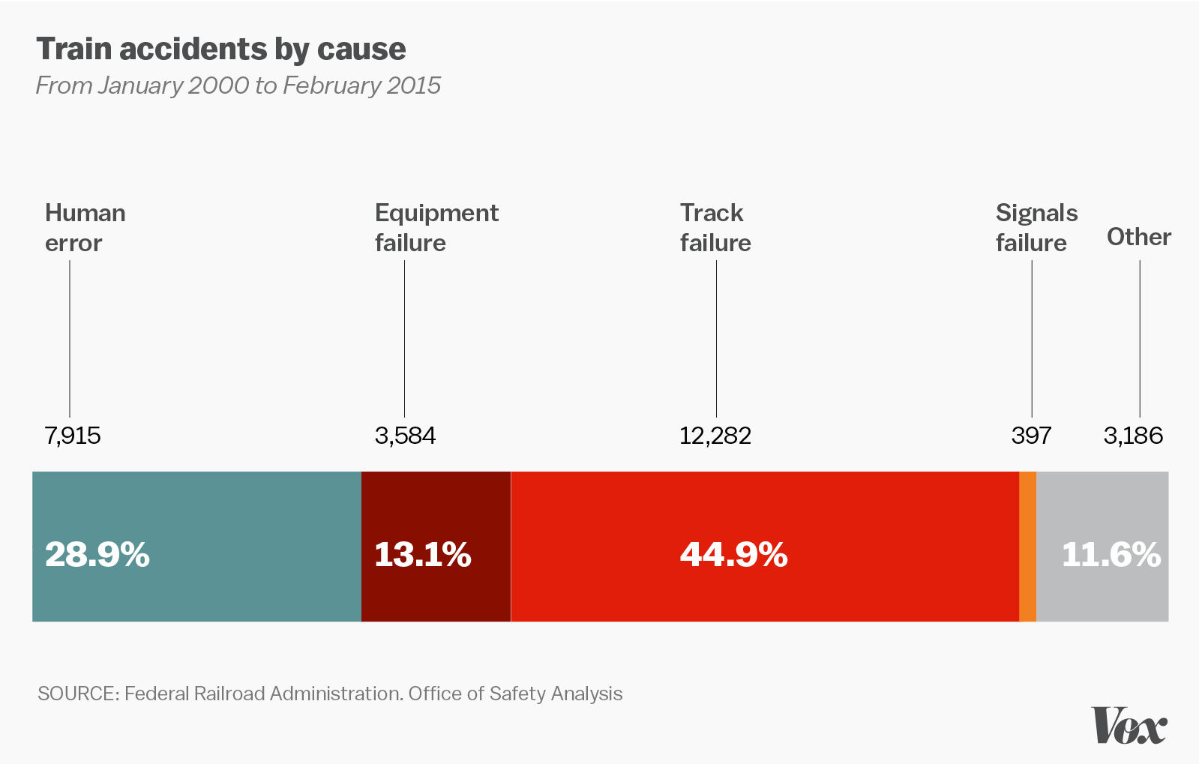


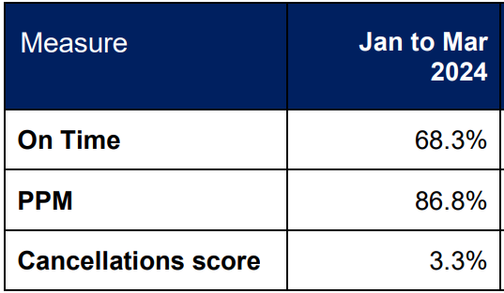

Introduction
Organizations like data centres, metro rail companies, and hospitals struggle with traditional, reactive maintenance approaches.
These approaches lead to prolonged downtimes, increased operational costs, and inefficient resource allocation as shown in the figure.
Many organizations face difficulties integrating and scaling predictive maintenance solutions due to issues like big data, system integration, and accuracy of predictive techniques.

Slide 4
Significance of Research
1. MINIMAL DOWNTIME
2. INCREASED LIFESPAN
3. RESOURCE ALLOCATION OPTIMIZATION
4. IMPROVED DECISION MAKING

Slide 5

Aim and Objectives
Aim The aim of this report is to develop an Equipment Lifecycle Management System that integrates various machine learning and deep learning techniques to predicting failures and improve equipment maintenance.
Objectives
Conduct a literature review on technological advancements in big data, ML, and AI for Equipment Lifecycle Management.
Identify challenges in applying big data and ML to Equipment Lifecycle Management.
Develop and implement models using ML and deep learning to optimize lifecycle management.
Assess model performance, noting strengths, weaknesses, and potential areas for improvement.

Slide 6

Research Questions
What contemporary ML and DL techniques are used in Asset and Equipment Lifecycle Management for Predictive Maintenance?
Which equipment attributes are most predictive of failures in Metro Railways?
How can feature engineering, data sampling, and feature selection improve predictive maintenance models for equipment failure?
Which ML or DL technique is best for predicting failures, and which performance metric is key for evaluation?
How will implementing predictive maintenance benefit Metro Railways and other industries, and influence decision-making?

Slide 7
Literature Review
SOURCE | RELEVANCE | METHODOLOGY | DETAILS | STRENGHTS | WEAKNESS | IMPACT
(Amram et al., 2021b) | 4 | Experimental – Logistic Regression, Random Forest, Decision Tree | Initiates various ML models and checks its performance in predicting failures. | Improves prediction accuracy which can be integrated into various systems. | Sole focus on decision tree technique. | Adopts a strategic and scalable solution to detecting failures using decision tree algorithms.

Slide 8
Literature Review
SOURCE | RELEVANCE | METHODOLOGY | DETAILS | STRENGHTS | WEAKNESS | IMPACT
(Li and Jung, 2023) | 4 | Experimental – LSTM and Autoencoders | LSTM and Autoencoders are used to identify abnormality of timepoints, intervals, and series | Structured comprehensive approach making use of diverse DL techniques used in addressing complex time-series data. | Interpreting the DL models such as LSTM and Autoencoders used, and its results can be complex. | Contribution to the field of anomaly detection.

Slide 9
Literature Review
SOURCE | RELEVANCE | METHODOLOGY | DETAILS | STRENGHTS | WEAKNESS | IMPACT
(Gupta, 2023) | 5 | Experimental - Autoencoders | Makes use of sparse and variational autoencoders on the digital and analogue sensor data. | Increase in performance levels of detecting anomalies and a reduction of false alarms. | Limits in exploring analogue dataset and comparing other models on the datasets involved. | Shows the importance of DL in predictions and detecting anomalies.

Slide 10
Literature Review
SOURCE | RELEVANCE | METHODOLOGY | DETAILS | STRENGHTS | WEAKNESS | IMPACT
(Alamr and Artoli, 2023) | 4 | Experimental – Transformers encoder | Transformer encoder anomaly detection using ECG5000 and MIT-BIH Arrhythmia datasets. | Outperforms other traditional models by achieving high levels of Accuracy, Precision and F1-score. | Lower performance on MIT-BIH Arrhythmia dataset. | Transformer models offer improved performance levels for detecting anomalies.

Slide 11
Literature Review
SOURCE | RELEVANCE | METHODOLOGY | DETAILS | STRENGHTS | WEAKNESS | IMPACT
(Achouch et al., 2022) | 3 | Review | Novel approach uses asset management and smart maintenance practices to help in point of failure detection and support decision making process. | Novel approach that integrates different sensors and maintenance approaches used for different machineries | New Research with lots of ground to cover . No applicable practical use. | Offers a complete view into the predictive maintenance and decision-making process.

Slide 12
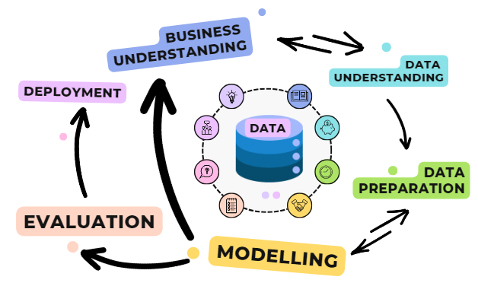
Research Philosophy
Research Philosophy adopted is the Critical Realism approach which is positivist and interpretivism based.
Tools:
Excel, R programming

Slide 13
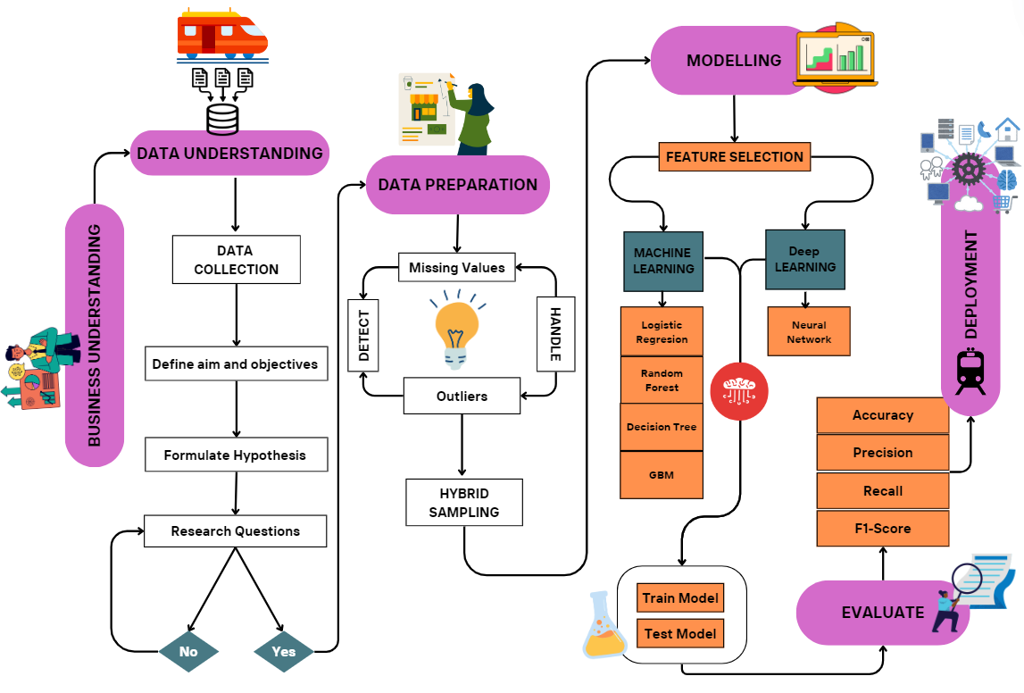
Research Methodology
MetroPT-3 Dataset
Metro
Railway
Station
80/20 Data split

Slide 14
Data Analysis Techniques
Dataset: MetroPT-3 site data with over 1 million rows and 16 columns.
Data Sampling: Hybrid sampling approach to address class imbalance
Model Development:
Select Prevalent Features
80/20 split, Logistic Regression, Decision Tree, Random Forest, Gradient Boosting Machine, and Neural Networks.
Model Evaluation: Accuracy, Precision, Recall and F1-score
Data Pre-processing: Ensure data quality and data reliability.
Exploratory Data Analysis (EDA): Explore patterns, trends, and variables relationship.
Engineer Failure column from given dates and time

Slide 15
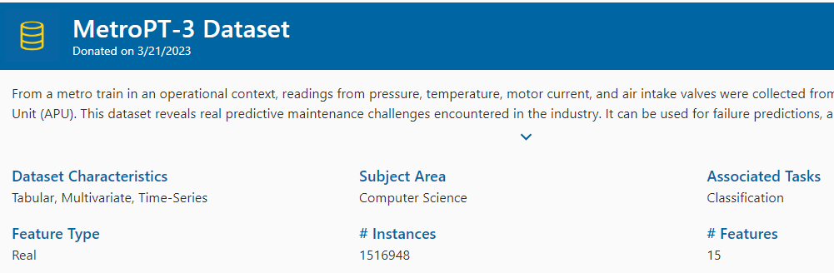
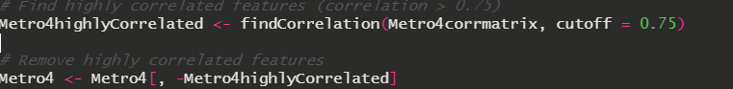
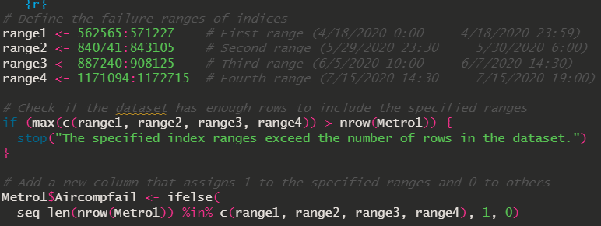
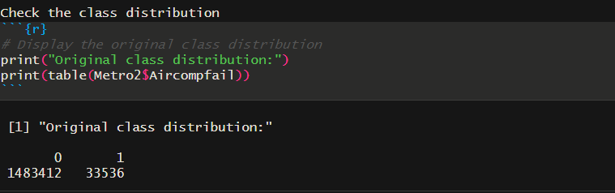

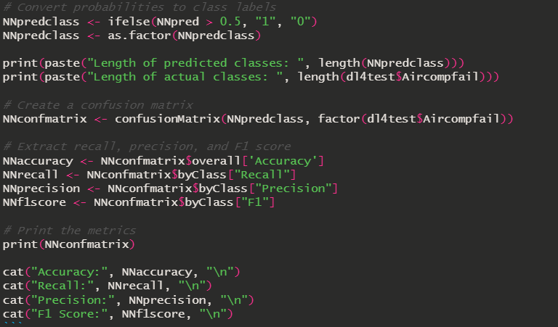
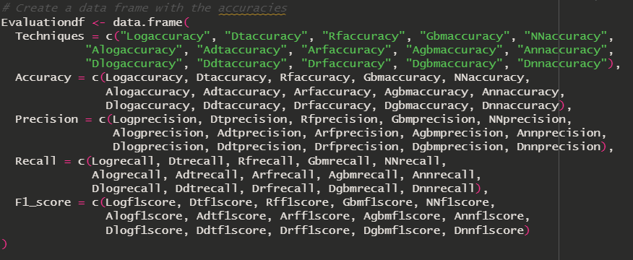
Implementation

Slide 16
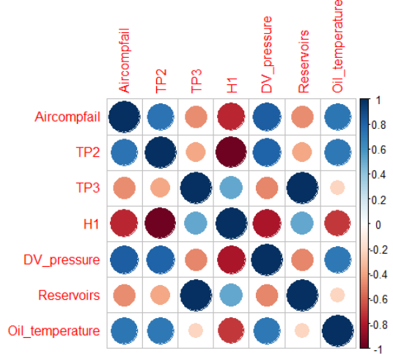
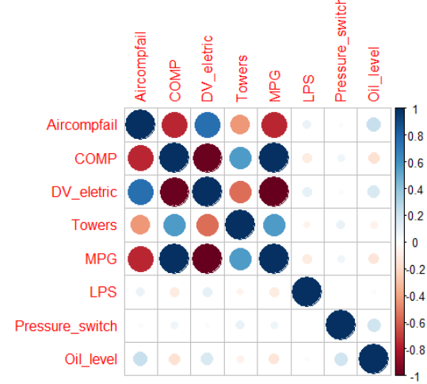
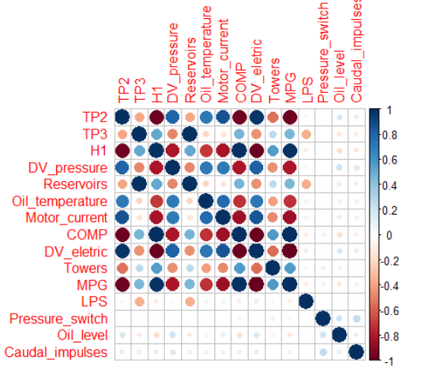
Feature Selection
Analog Dataset
Digital Dataset
MetroPT-3 Dataset

Slide 17
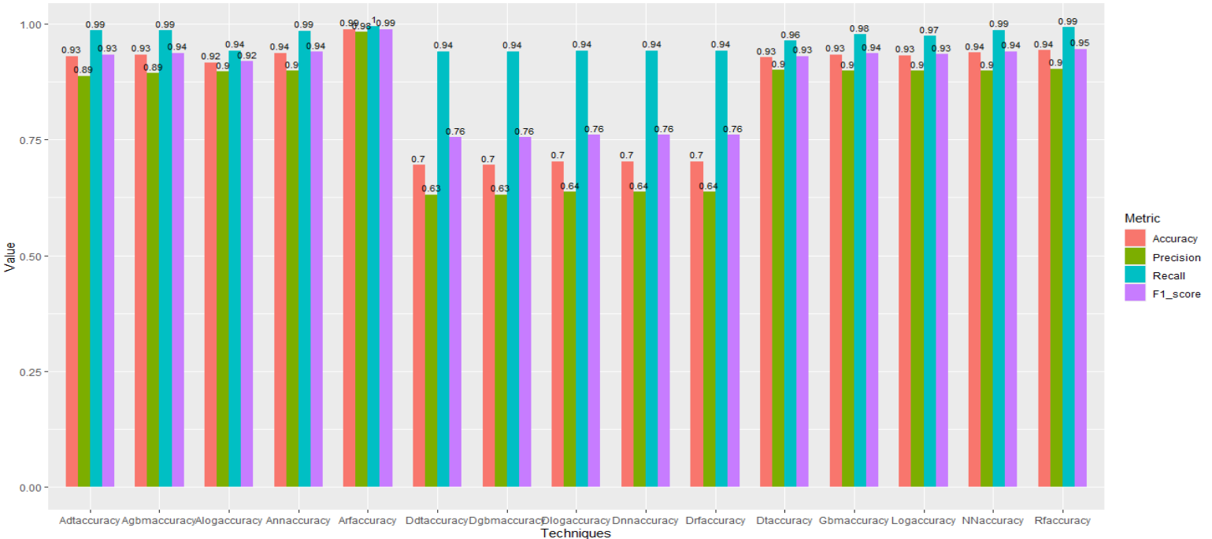
Performance Metric Chart

Slide 18
Model Ranking
S/N | MODEL | MetroPT-3 Dataset |  | Analogue Sensor Dataset |  | Digital Sensor Dataset
 |  | Accuracy | F1-Score | Accuracy | F1-Score | Accuracy | F1-Score
1 | Logistic Regression | 0.9321386 | 0.9349089 | 0.9170735 | 0.9191520 | 0.7028913 | 0.7604012
2 | Decision Tree | 0.9283949 | 0.9308466 | 0.9304853 | 0.9341695 | 0.6955602 | 0.7555654
3 | Random Forest | 0.9435982 | 0.9462860 | 0.9887900 | 0.9888664 | 0.7028913 | 0.7604012
4 | GBM | 0.9338117 | 0.9366082 | 0.9343483 | 0.9375885 | 0.6955602 | 0.7555654
5 | Neural Network | 0.9380123 | 0.9409244 | 0.9372720 | 0.9401799 | 0.7028913 | 0.7604012
6 | Hybrid Model | N/A |  | 0.9393089 | 0.9422346 | N/A

Slide 19
Prior Research Vs Major Research Contribution
Prior Research
Major Contribution
Model comparison: LR, RF, DT, GBM,NN, and Hybrid (RF & NN).
Improved Accuracy score of 98.83%, Precision of 98.2%, Recall of 99.5% and F1-score of 98.9%
(Davari et al., 2021) uses Variational Autoencoders and Sparse Autoencoders with 45% and 34% F1-score.
(Nair et al., 2024) has Precision of 98.2% and Recall of 98.7%
Data sampling to address over or underfitting

Slide 20

Key Findings
Significant increase in the use of big data and machine learning for optimizing Asset and Equipment Lifecycle Management.
Predictive maintenance techniques like Random Forest, Decision Tree, Neural Networks, etc., improve operational efficiency and reduce downtime.
Best Dataset: The Analogue dataset provided the most accurate predictions compared to the digital and entire MetroPT-3 datasets.
Best Performing Model: Random Forest achieved the highest and most consistent evaluation metrics across all models.
Hybrid Model Approach combines Random Forest and Neural Network with Accuracy – 93.9 % (Second best model)

Slide 21

Conclusions
Limitations:
Ethical concerns related to data privacy and security in predictive maintenance applications.
Lack of transparency, fairness, and model interpretability may impact model effectiveness and adoption.
Lack of computational power to run more models
Recommendations and Future Work:
Integrate diverse data sources to further enhance machine learning and deep learning models.
Explore more advanced deep learning techniques such as RNN, CNN, LSTM, and Autoencoders.

Slide 22

References
Achouch, M., Dimitrova, M., Ziane, K., Sattarpanah Karganroudi, S., Dhouib, R., Ibrahim, H. and Adda, M. (2022) ‘On Predictive Maintenance in Industry 4.0: Overview, Models, and Challenges.’ Applied Sciences. Multidisciplinary Digital Publishing Institute, 12(16) p. 8081.
Alamr, A. and Artoli, A. (2023) ‘Unsupervised Transformer-Based Anomaly Detection in ECG Signals.’ Algorithms, 16(3) p. 152.
Amram, M., Dunn, J., Toledano, J. J. and Zhuo, Y. D. (2021b) ‘Interpretable predictive maintenance for hard drives.’ Machine Learning with Applications, 5, September, p. 100042.
Chauhan, S. and Vig, L. (2015) ‘Anomaly detection in ECG time signals via deep long short-term memory networks.’ In 2015 IEEE International Conference on Data Science and Advanced Analytics (DSAA). Campus des Cordeliers, Paris, France: IEEE, pp. 1–7.
Davari, N., Veloso, B., Ribeiro, R. P., Pereira, P. M. and Gama, J. (2021) ‘Predictive maintenance based on anomaly detection using deep learning for air production unit in the railway industry.’ In 2021 IEEE 8th International Conference on Data Science and Advanced Analytics (DSAA). Porto, Portugal: IEEE, pp. 1–10.
Gupta, V. A. (2023) ‘Metro Rail — Predictive Maintenance Based On Anomaly Detection.’ Medium. 11th December. [Online] Available from: https://medium.com/@vgupta701/metro-rail-predictive-maintenance-based-on-anomaly-detection-0008ffa7a5b7 [Accessed on 6th September 2024].
Li, G. and Jung, J. J. (2023) ‘Deep learning for anomaly detection in multivariate time series: Approaches, applications, and challenges.’ Information Fusion, 91, March, pp. 93–102.
Nair, Vishak, Premalatha M, Srinivasa Perumal R, and Braveen M. “Enhancing Metro Rail Efficiency: A Predictive Maintenance Approach Leveraging Machine Learning and Deep Learning Technologies,” May 23, 2024. https://doi.org/10.21203/rs.3.rs-4319916/v1.

Slide 23

Thank You!
Questions?
Oluwatosin Ojo - 2312602
Data Engineer
oao3crt@bolton.ac.uk

